Slide 1
Title: Predictive Modeling of Historical Stock Prices Using Google Stock Data By: Eric Schneider

Slide 2
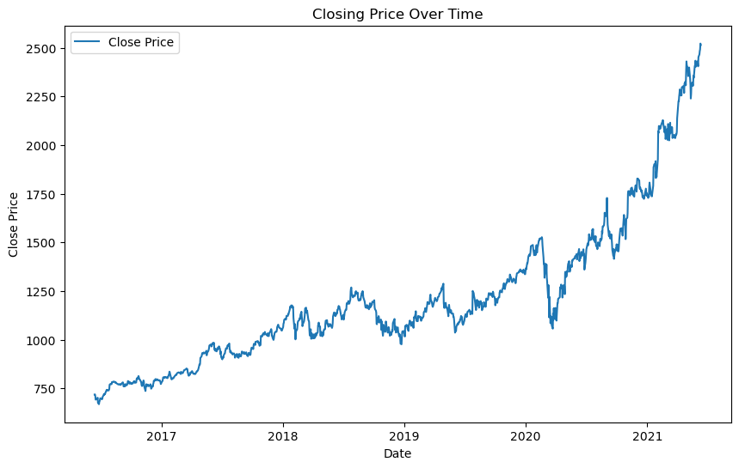
Overview:
The goal of this study is to predict future stock prices using historical data from Google (GOOG) stock.
By analyzing stock data, we aim to create a model that accurately forecasts stock prices.
Importance:
Stock price prediction is crucial for investors and financial analysts to make informed decisions.
Accurate predictions can lead to better investment strategies and financial planning.
Objective:
Develop a predictive model using historical stock data.
Evaluate the model's performance and its ability to forecast future prices.

Slide 3

Source: The dataset contains historical stock data for Google (GOOG) from June 2016 to June 2020. The data includes daily stock prices and trading volume. Key Variables: Date: The date of the stock trading day. Open: The opening price of the stock. High: The highest price of the stock during the day. Low: The lowest price of the stock during the day. Close: The closing price of the stock. Volume: The number of shares traded. Adjusted Close: The closing price adjusted for splits and dividends. Dataset Size: The dataset consists of 1,007 entries with 13 variables.
 | symbol | date | close | high | low | open | volume | adjClose | adjHigh | adjLow | adjOpen | adjVolume | divCash | splitFactor
0 | GOOG | 2016-06-14 00:00:00+00:00 | 718.27 | 722.47 | 713.1200 | 716.48 | 1306065 | 718.27 | 722.47 | 713.1200 | 716.48 | 1306065 | 0.0 | 1.0
1 | GOOG | 2016-06-15 00:00:00+00:00 | 718.92 | 722.98 | 717.3100 | 719.00 | 1214517 | 718.92 | 722.98 | 717.3100 | 719.00 | 1214517 | 0.0 | 1.0
2 | GOOG | 2016-06-16 00:00:00+00:00 | 710.36 | 716.65 | 703.2600 | 714.91 | 1982471 | 710.36 | 716.65 | 703.2600 | 714.91 | 1982471 | 0.0 | 1.0
3 | GOOG | 2016-06-17 00:00:00+00:00 | 691.72 | 708.82 | 688.4515 | 708.65 | 3402357 | 691.72 | 708.82 | 688.4515 | 708.65 | 3402357 | 0.0 | 1.0
4 | GOOG | 2016-06-20 00:00:00+00:00 | 693.71 | 702.48 | 693.4100 | 698.77 | 2082538 | 693.71 | 702.48 | 693.4100 | 698.77 | 2082538 | 0.0 | 1.0

Slide 4

Handling Missing Values: Confirmed there were no missing values in the dataset. Date Conversion: Converted the 'date' column to datetime format for easier manipulation and analysis. Feature Engineering: Created additional features: 'year', 'month', and 'day' from the 'date' column to capture temporal patterns. Standardization: Standardized numerical features to have a mean of 0 and a standard deviation of 1.

Slide 5
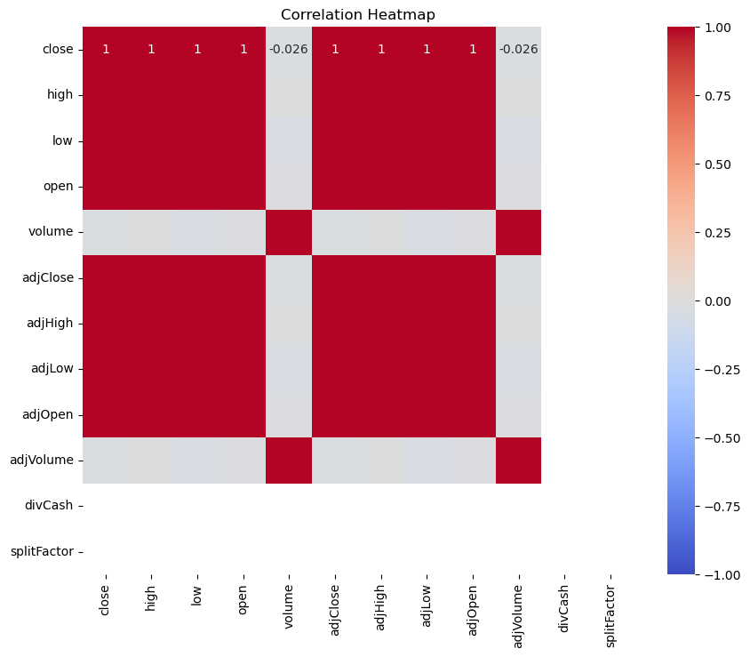
Distribution of Key Variables: Visualized the distribution of stock prices (close, high, low, open) to understand their behavior. Volume Trends: Analyzed the volume trends over time to identify patterns in trading activity. Correlation Analysis: Conducted correlation analysis to identify relationships between variables. Strong correlation observed among 'close', 'high', 'low', and 'open' prices.

Slide 6
Feature Engineering:
Created additional features such as moving averages and daily returns to capture stock trends.
Handling Missing Values:
Verified no missing values in the dataset. Scaling and Normalization:
Standardized numerical features to ensure consistent scaling.
Encoding Categorical Variables:
Converted categorical variables using one-hot encoding.
# Determine the split point (80% training, 20% testing)
train_size = int(len(df) * 0.8)
# Split the data into training and testing sets
train, test = df[:train_size], df[train_size:]
# Separate features and target
X_train, y_train = train[features], train[target]
X_test, y_test = test[features], test[target]
# Verify the split
print(f'Training set: {len(X_train)} samples’)
print(f'Testing set: {len(X_test)} samples')

Slide 7
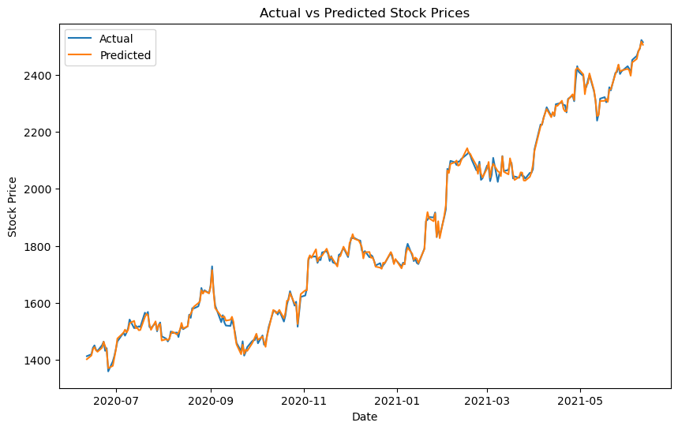
Trend Analysis:
Visualized stock price trends over time to identify patterns and seasonality.
Volume Analysis:
Examined trading volume to understand market activity.
Correlation Analysis:
Analyzed correlations between features to understand relationships and multicollinearity.

Slide 8
Feature Selection:
Selected relevant features for modeling (e.g., 'close', 'volume', 'adjClose', 'adjVolume’).
Handling Missing Values:
Confirmed no missing values in the dataset.
Normalization and Standardization:
Applied MinMax scaling to normalize feature values.
Creating Time Series Features:
Generated lag features and moving averages to capture historical trends.

Slide 9

Models Tested:
Linear Regression
Decision Tree Regressor
Random Forest Regressor
Evaluation Metrics:
Mean Squared Error (MSE)
Root Mean Squared Error (RMSE)
R-squared
Performance Comparison:
Random Forest Regressor performed the best with the lowest MSE and highest R-squared value.
Linear Regression showed moderate performance.
Decision Tree Regressor had higher variance and was prone to overfitting.
symbol | date | close | high | low | open | volume | adjClose | adjHigh | adjLow | adjOpen | adjVolume | divCash | splitFactor | day_of_week
0 | GOOG | 2016-06-14 00:00:00+00:00 | 718.27 | -1.303405 | -1.296941 | -1.304701 | -0.424763 | 718.27 | 722.47 | 713.1200 | 716.48 | 1306065 | 0.0 | 1.0 | -0.733253
1 | GOOG | 2016-06-15 00:00:00+00:00 | 718.92 | -1.302088 | -1.285875 | -1.298110 | -0.556347 | 718.92 | 722.98 | 717.3100 | 719.00 | 1214517 | 0.0 | 1.0 | -0.018743
2 | GOOG | 2016-06-16 00:00:00+00:00 | 710.36 | -1.318427 | -1.322983 | -1.308808 | 0.547447 | 710.36 | 716.65 | 703.2600 | 714.91 | 1982471 | 0.0 | 1.0 | 0.695767
3 | GOOG | 2016-06-17 00:00:00+00:00 | 691.72 | -1.338638 | -1.362094 | -1.325183 | 2.588274 | 691.72 | 708.82 | 688.4515 | 708.65 | 3402357 | 0.0 | 1.0 | 1.410276
4 | GOOG | 2016-06-20 00:00:00+00:00 | 693.71 | -1.355003 | -1.348998 | -1.351027 | 0.691275 | 693.71 | 702.48 | 693.4100 | 698.77 | 2082538 | 0.0 | 1.0 | -1.447763

Slide 10
Questions?

